Slide 1
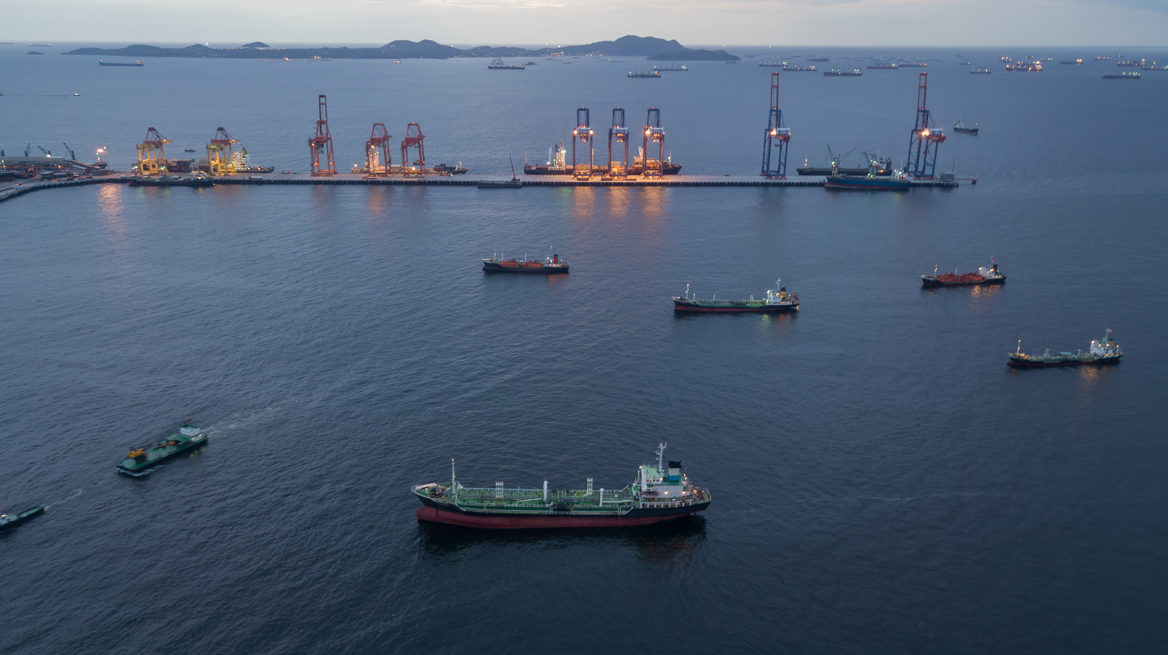



Regulamentation in different countries worldwide: the importance of wildlife protection and response strategies within contingency plans
PREVENT / PREPARE / RESPOND / RESTORE
Brigida Gandini, Driellie Melo, Viviane Barquete,
Valeria Ruoppolo

Slide 2



Introduction
Contingency plans for oil spill accidents:
  The primary goal is preparing organizations and authorities for a coordinated and efficient response
Minimize financial impacts,
Facilitate the recovery of affected areas,
Promote effective communication, and
Ensure legal compliance
Preventing harm to ecosystems,
Safeguarding human health, and
Ensuring public safety

Slide 3
Introduction
Environmental regulation has historically evolved in reaction to disasters.
In countries with oil exploration, contingency plans are common.
However, they rarely address local wildlife protection.
Despite comprehensive contingency plans, many countries fail to address wildlife protection adequately.
Environmental responsibility must go beyond legal obligations.

Slide 4
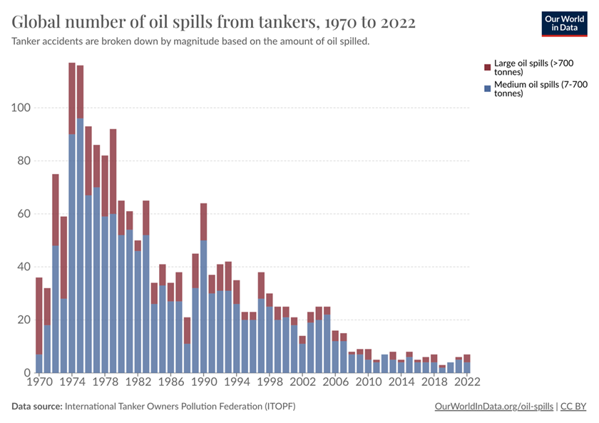
Introduction
Wildlife protection is often overlooked in contingency plans.
  Critical failure!
A global approach is necessary to integrate wildlife response into legislation.
Major oil spills over the years have been the triggers for operational enhancements and legislative improvements, leading to increased safety measures that have reduced accidents over the past 20 years.

Slide 5
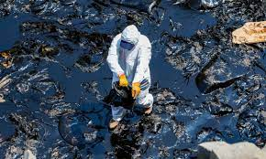
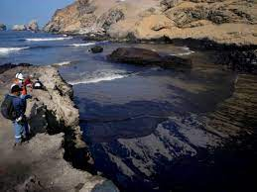
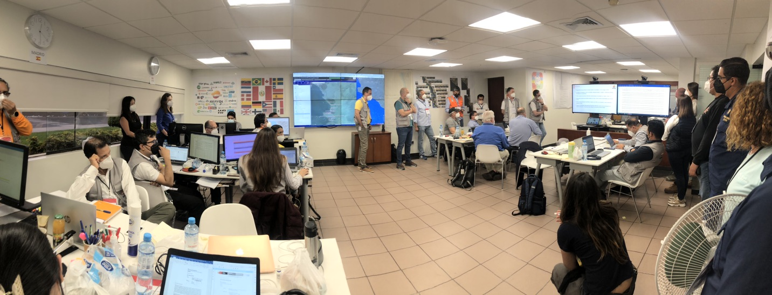
Case Study: 2022 Oil Spill in Peru
Lack of wildlife response guidelines
National Disaster Risk Management System (Law No. 29664, 2011) did not include wildlife response
  The incident exposed significant gaps
Incident led to the creation of a specific manual
  Authorities had to create a manual post-disaster, highlighting the need for preemptive action.

Slide 6
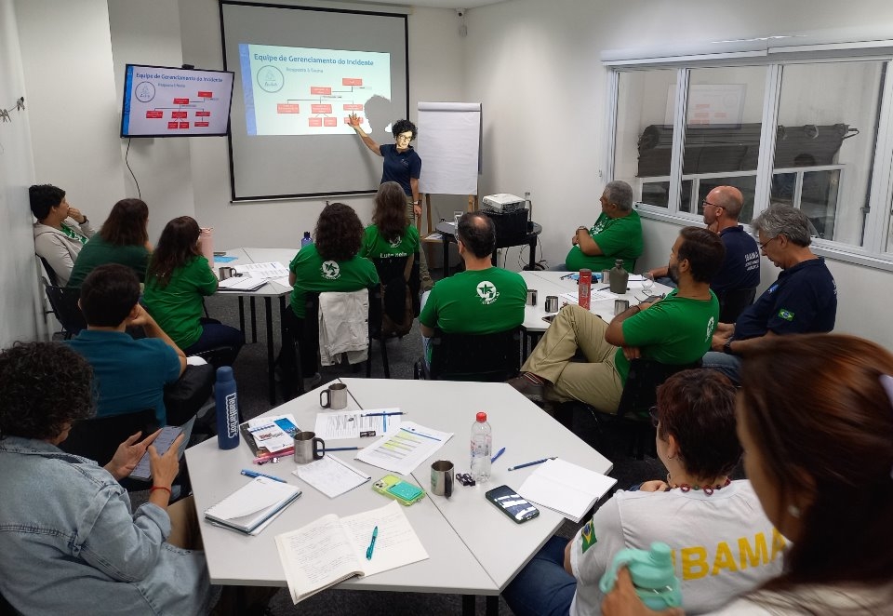


Need for Legislative Integration
Include wildlife protection in regulatory frameworks.
Contingency plans must include clear measures.
Encourage companies to adopt preventive practices.
Legislation can be reviewed and strengthened based on lessons learned to enhance prevention and response to future incidents

Slide 7
Essential Elements for Response Plans
Risk Assessment and Wildlife Sensitivity Mapping
Clear Roles and Responsibilities
Wildlife Response Strategies and Protocols
Specialized Equipment and Resources
Regulatory Compliance
Training and Drills
Emergency Notification and Communication

Slide 8
Legislative Comparison – OPRC 90
Comparing prevention initiatives and adherence to OPRC 90
  Enhance global capacity for responding to oil spills and mitigate pollution damage in international waters
Key aspects examined:
  Regulatory entities
  International cooperation
  Wildlife protection commitments
  Geographical scope
Main Research Objectives
Identify standards for the development and approval of contingency plans
Highlight the most effective regulations in wildlife protection
Provide references for other countries

Slide 10
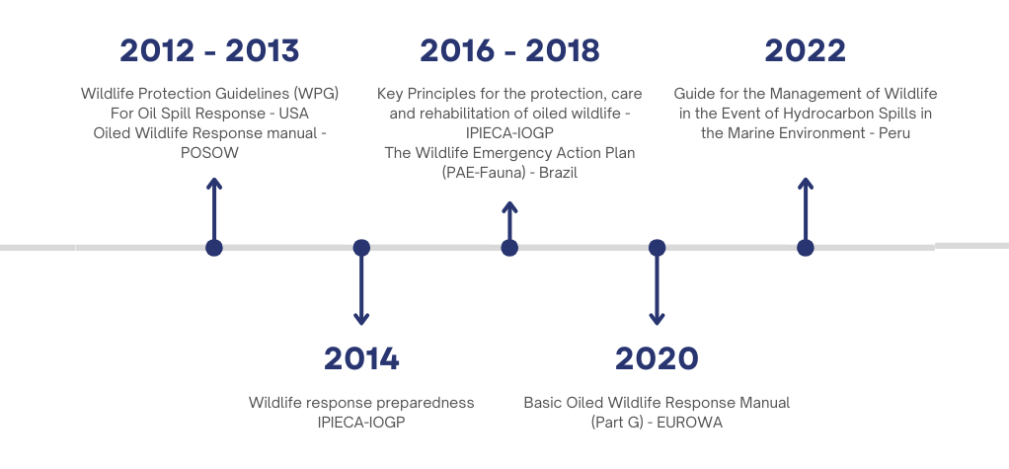
Summary of wildlife response protocols and manuals
In the countries studied...

Slide 11

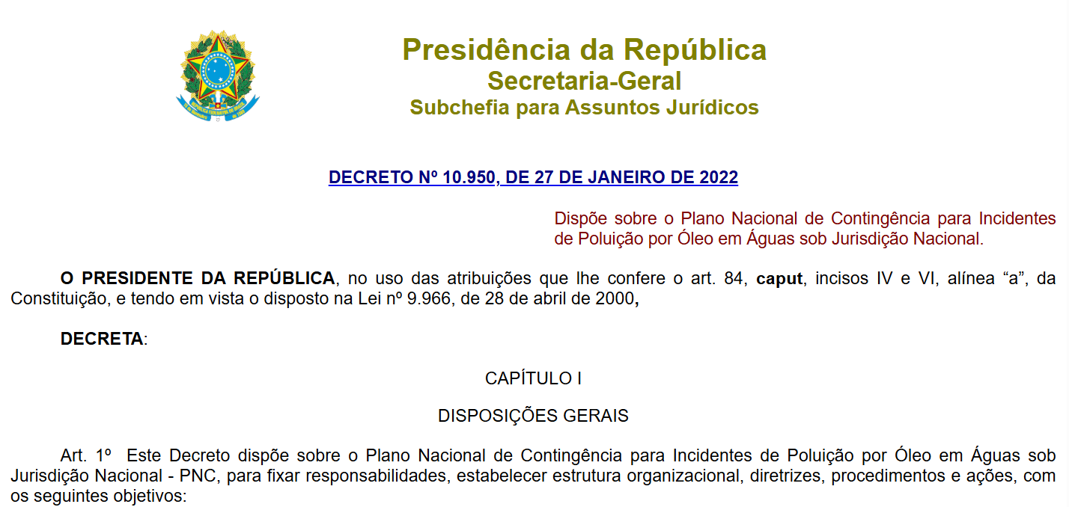
Key Findings
Few countries have explicit wildlife protection in contingency plans.
Legislations were drafted and enacted between the 90s and 2000s but with a major gap between the drafting and the effective implementation.
Many countries present a lack of specific legislation to deal with wildlife emergencies.
  Challenges in the execution of efficient rescue and recovery measures.
Brazil is one of them

Slide 12
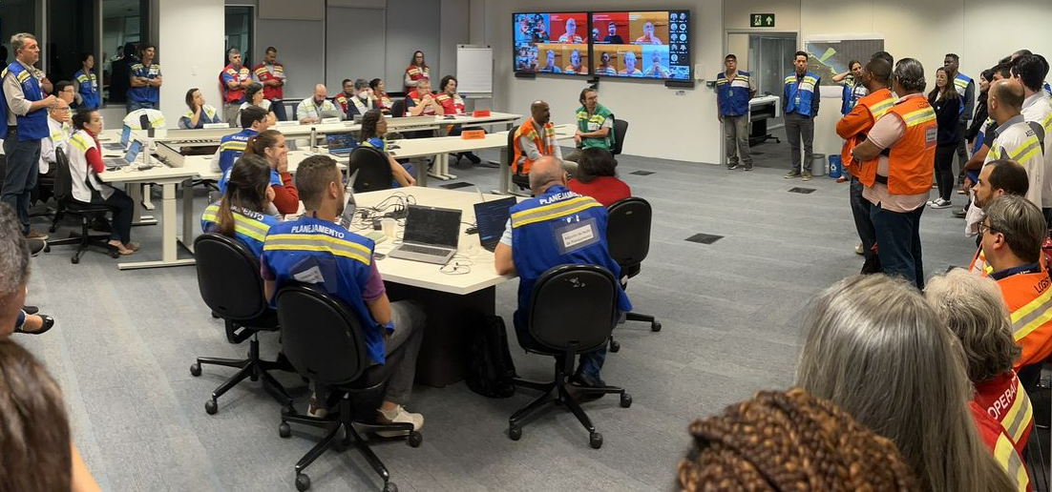
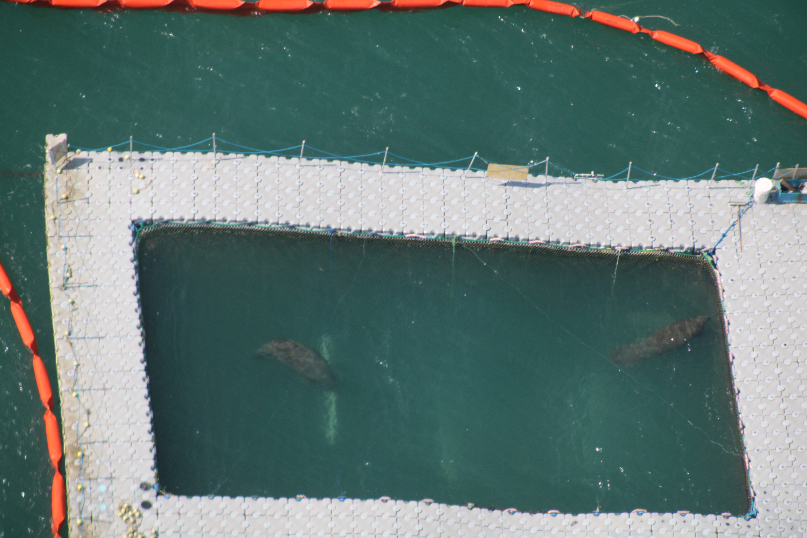
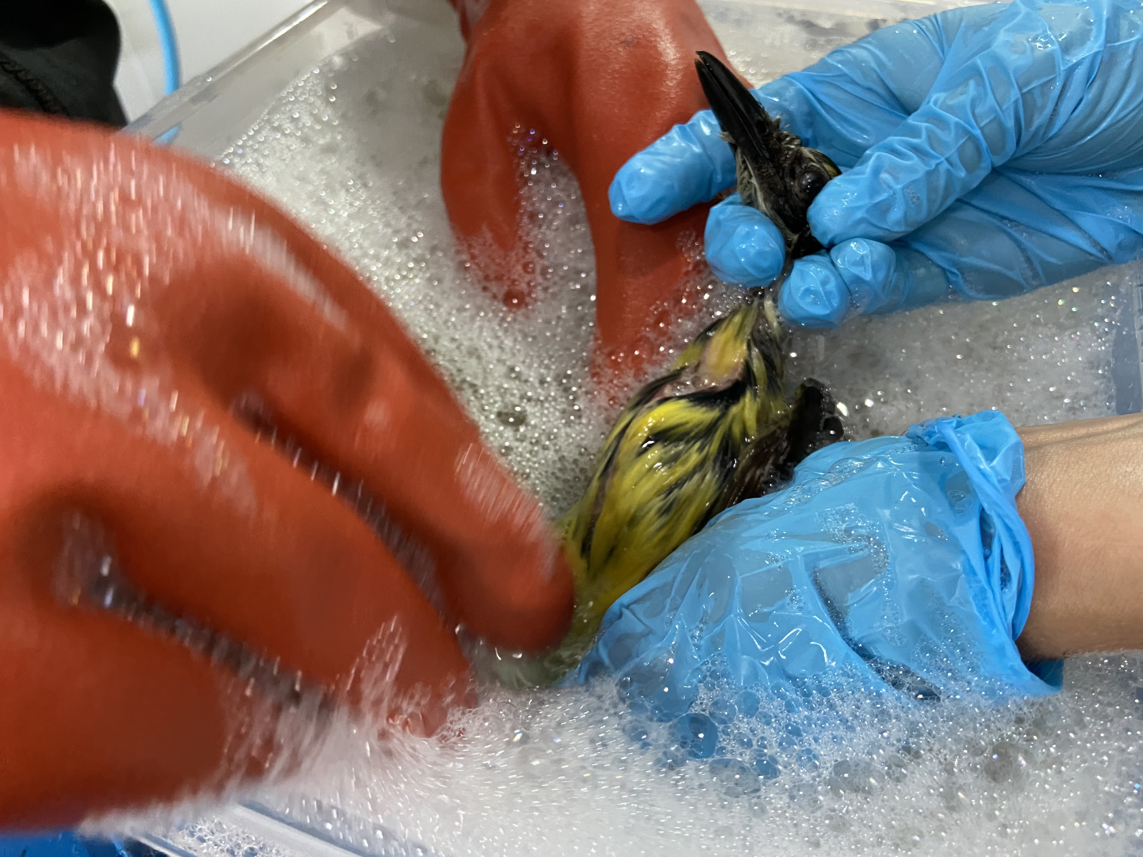
Corporate Environmental Responsibility
Environmental responsibility extends beyond compliance.
A robust wildlife protection plan supports sustainability and reduces financial and legal risks.
Integration of wildlife preparedness ensures a responsible environmental management approach.

Slide 13

Conclusion and Recommendations​
Governments should integrate wildlife response into legislation.
  Strong regulations enhance emergency response effectiveness.
Industry must adopt proactive measures beyond legal obligations.
  Corporate initiatives can play a key role in biodiversity protection
Clear guidelines and adequate resources are essential for effective wildlife protection.
Integration between regulations and corporate initiatives in the protection of wildlife in oil spill emergencies is key to responsible management.

Slide 14
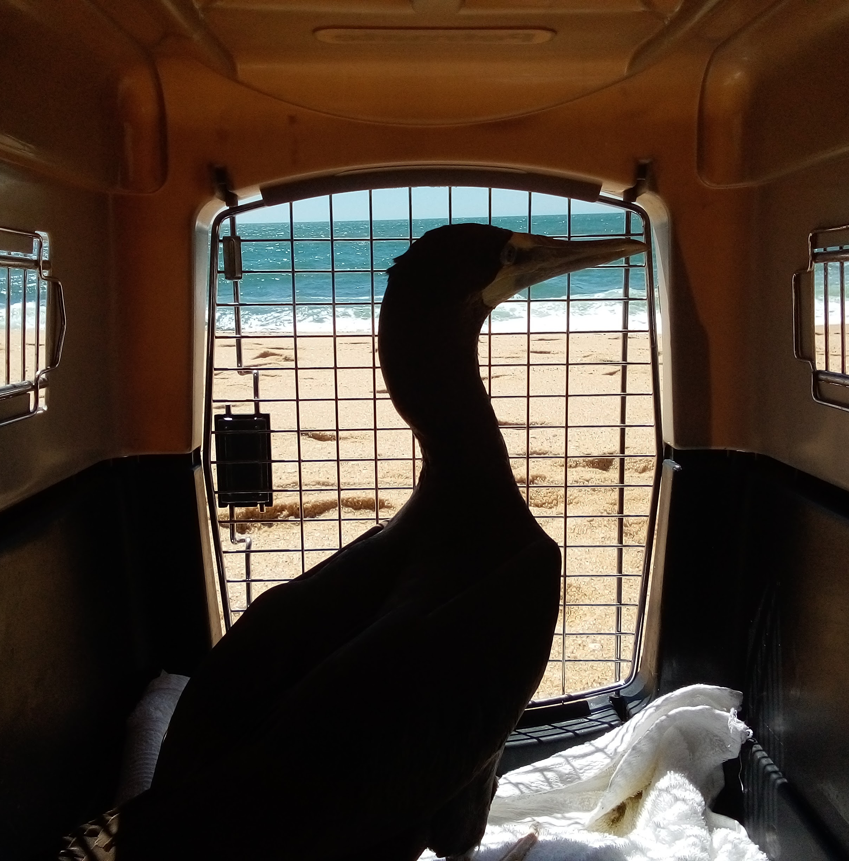
Questions and
Discussion
Thank you for your attention!
Questions and discussions are welcome.

